Slide 1


Comparative Analysis of Food Security in Rural and Urban Areas: A Statistical Approach
Kazi Abdullah Jarif, Mst. Nadiya Noor
American International University-Bangladesh (AIUB), Dhaka-1229.

Slide 2
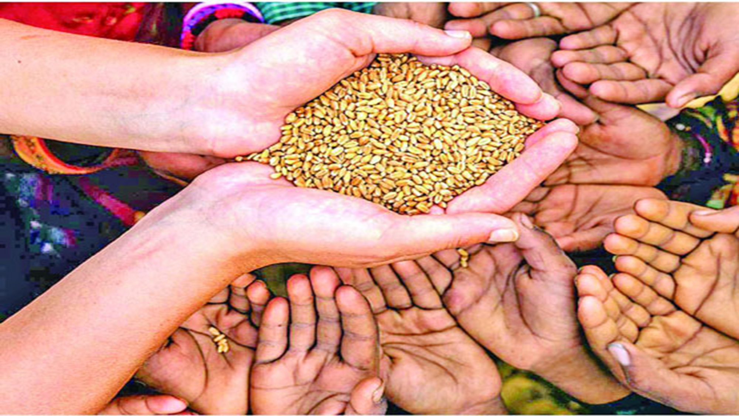

Overview of Abstract
This study highlights the importance of addressing the socio-economic differences affecting food security across different regions.
Topic: Comparative analysis of food security in rural and urban areas.
Focus: Variations in food security based on geographical locations, socio-economic condition and infrastructure differences.
Key Factors: Rural areas face more food insecurity due to poverty, poor infrastructure and market access, while urban areas deal with high living costs and unemployment.
Study Objective: To statistically compare food security between rural and urban regions in Bangladesh.

Slide 3

Background of the study
Definition of food security
Rural vs urban food security
Factors affecting food security
Study objective
Data source

Slide 4


Objective of the study
To conduct a comparative analysis of food security levels in rural and urban areas of Bangladesh.
To identify the unique challenges faced by rural and urban populations in terms of access to sufficient, safe and nutritious food.
To analyze key factors such as household dwelling types, sources of drinking water, household income and other socio-economic aspects that impact food security.
To utilize this analysis to inform policies and recommend targeted strategies that can improve food security for both rural and urban populations in Bangladesh.

Slide 5

Methods and methodology
Data Source
Collected from the Bangladesh Bureau of Statistics’ Food Security Statistics (2022-2023).
Sample Population
Representative samples from rural and urban populations across eight divisions: Barisal, Chattogram, Dhaka, Khulna, Mymensingh, Rajshahi, Rangpur, Sylhet.
Key variables analyzed
Household dwelling type, drinking water sources, primary income sources and socio-economic factors.

Slide 6
Methods and methodology
Data Collection Technique
Comprehensive survey covering socio-economic and environmental factors influencing food security.
Data analysis approach
Statistical analysis including descriptive, comparative, and regression methods to highlight rural-urban disparities.
Focus on food insecurity indicators
Analysis of severe and moderate food insecurity by geographic location to identify high-risk areas and socio-economic factors.

Slide 7

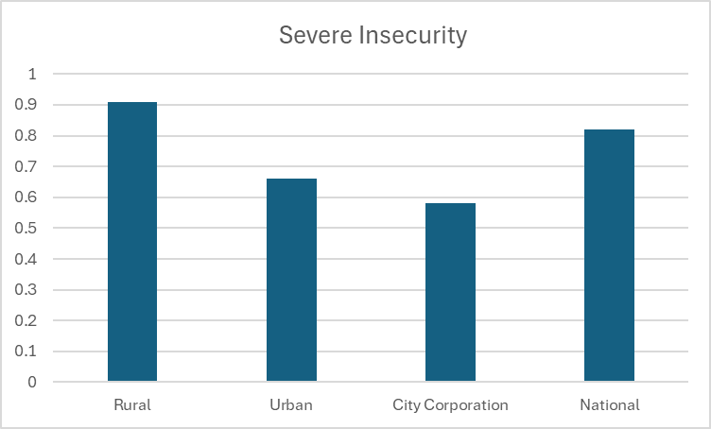
Result and discussion
Figure 1: Severe Insecurity (in percent of household) Situation by Residence

Slide 8
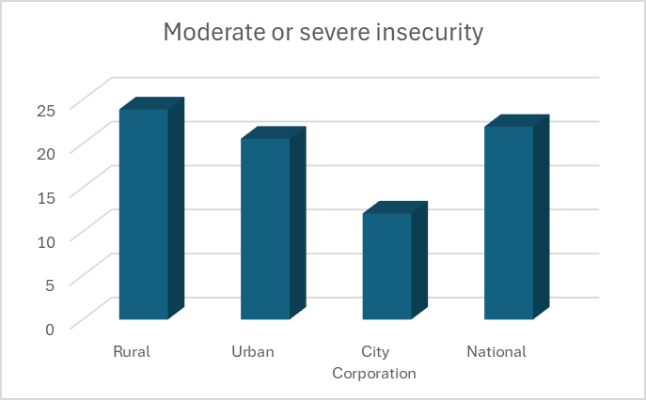
Result and discussion
Figure 2: Moderate or Severe Insecurity (in percent of household) Situation by Residence

Slide 9
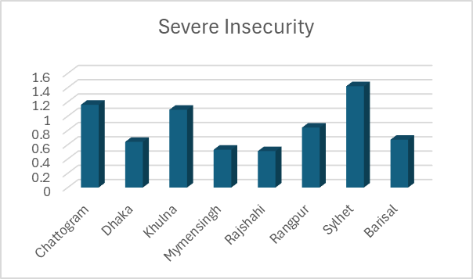
Result and discussion
Figure 3: Severe Insecurity (in percent of households) Situation by Division

Slide 10

Conclusion
In conclusion, our statistical analysis reveals significant disparities in food security between rural and urban areas, emphasizing the necessity for targeted strategies that address access, nutritional quality, and economic factors to improve overall food security across the country.

Slide 11

Notes:
The some of the information was adapted or excerpt from http://pubs.acs.org/paragonplus/submission/jacsat/jacsat_authguide.pdf

Slide 12

THANK YOU

